Slide 1
VII.3 SOFTWARE PROJECT MANAGEMENT

Slide 2
PERT
PERT uses the network schedule to represent a project schedule while taking the uncertainties into account.
Time Estimates in PERT
PERT is a probabilistic technique that uses three time estimates: It assumes that activity times are represented by a probability distribution. To finish an activity, it bases the probability distribution of activity time on three time estimates:
Optimistic time
Pessimistic time
Most likely time

Slide 3
Contd..
The optimistic time is the shortest time period within which an activity can end if everything goes well.
The pessimistic time is the time that an activity takes to complete if everything that can go wrong goes wrong. This is the longest time that an activity can take to complete.
The most likely time is the estimate of the normal time that an activity takes to complete.

Slide 4
Contd..
To calculate the expected time for each activity, you use the following equation:
T_{e}=(T₀+4T_{m}+T_{p})/6
where T_{e} is the expected time, T₀ is the optimistic time, T_{m} is the most likely time, and T_{p} is the pessimistic time required to complete an activity.

Slide 5
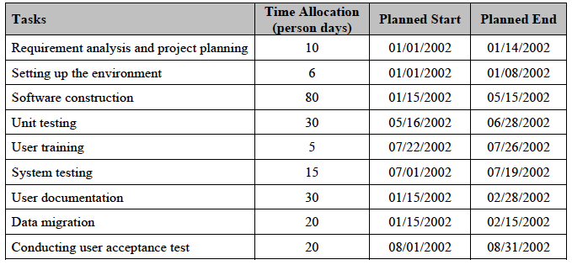
Example: Project Activities and Time Allocation Details

Slide 6
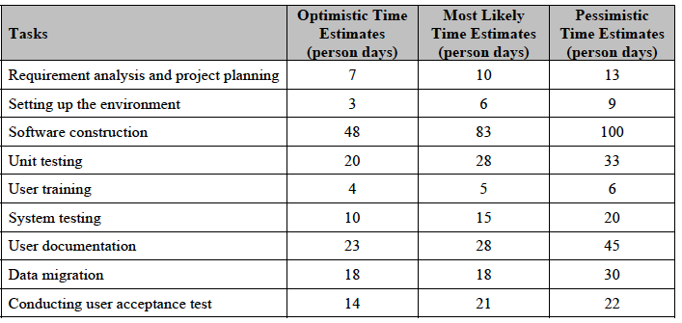
Contd..

Slide 7
Estimating time for requirement analysis & project planning
Te = [7+4(10)+13]/6
= 60/6
= 10 person days

Slide 8
Case study 8
Complete the above activities. Estimating time for requirement analysis & project planning.

